Slide 1
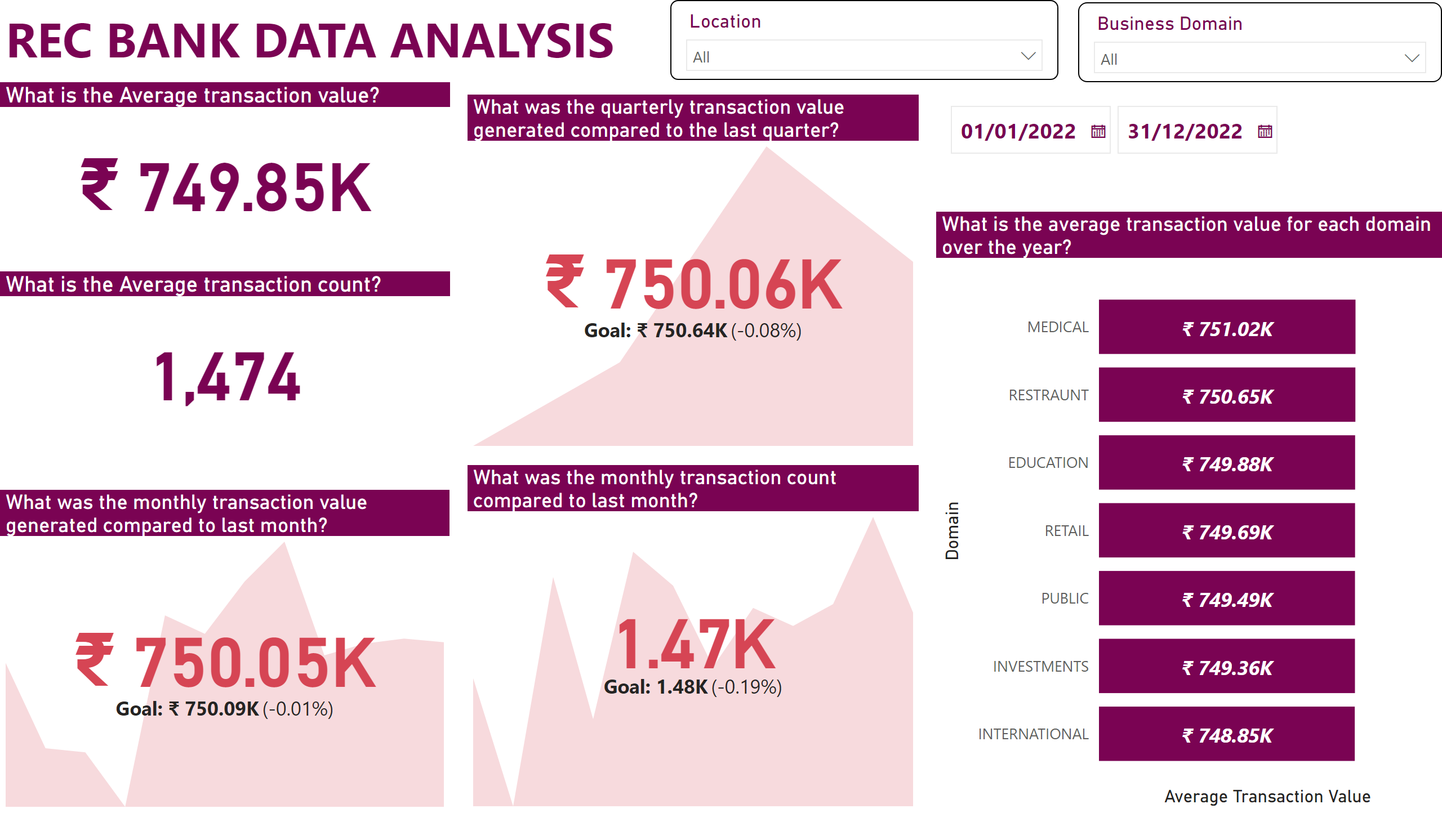
Executive Report
Notes:
What was the monthly transaction value generated compared to last month?
No alt text provided
textbox
No alt text provided
slicer
No alt text provided
What is the Average transaction value?
No alt text provided
slicer
No alt text provided
What is the Average transaction count?
No alt text provided
What was the quarterly transaction value generated compared to the last quarter?
No alt text provided
What was the monthly transaction count compared to last month?
No alt text provided
What is the average transaction value for each domain over the year?
No alt text provided
slicer
No alt text provided

Slide 2
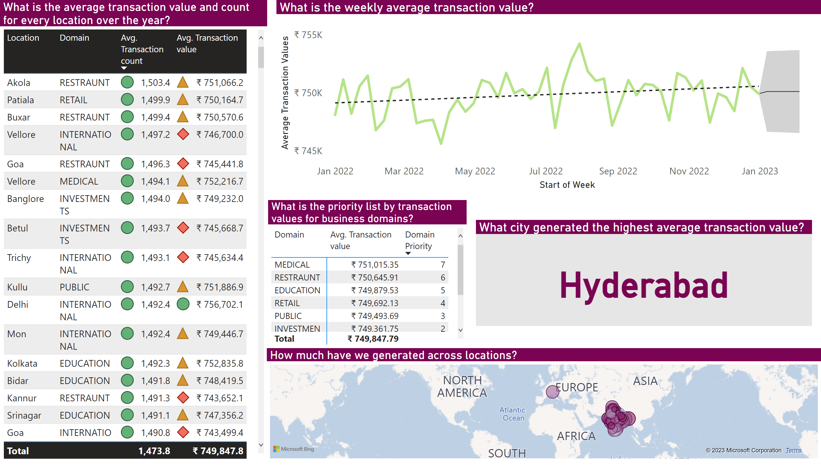
Detailed Report
Notes:
What is the weekly average transaction value?
No alt text provided
What is the average transaction value and count for every location over the year?
No alt text provided
What city generated the highest average transaction value?
No alt text provided
How much have we generated across locations?
No alt text provided
What is the priority list by transaction values for business domains?
No alt text provided

